Slide 1

Big Cities Health Coalition
http://www.bigcitieshealth.org/
Team Members: Hasib, Brian Kramer, Jarrett Campbell, Stephen Seyer

Slide 2
Research questions
1.
2.
3.
4.
5.

Slide 3
Business Objective
The dataset we used provides mortality rates for multiple major illnesses across 30+ major cities around the US. Purpose: The purpose of this website is to automatically create informative visualizations based around the users selected data from the KEY INDICATORS. Users will use dropdowns on the website to drill down to what kind of data they want to see.
Visuals Chart Types: • Pie • Bar • Line • Scatter
IE: Any user visits that website can go in and select what data they want to see involving Maternal and Child Health, by selecting that from the indicator category. After selection, the indicator dropdown will populate with illnesses related to their selection. That will then populate the year dropdown with all the available years, the sex dropdown with available genders, race dropdown with available races, and finally the location dropdown. Once their selections are made, they can click the submit button. This will provide a list of available chart types that will display their data. If a user selects an indicator and only wants to break the data by sex, then a pie chart would be listed. If they are trying to compare multiple indicators across multiple locations, then we may propose a line chart.

Slide 4
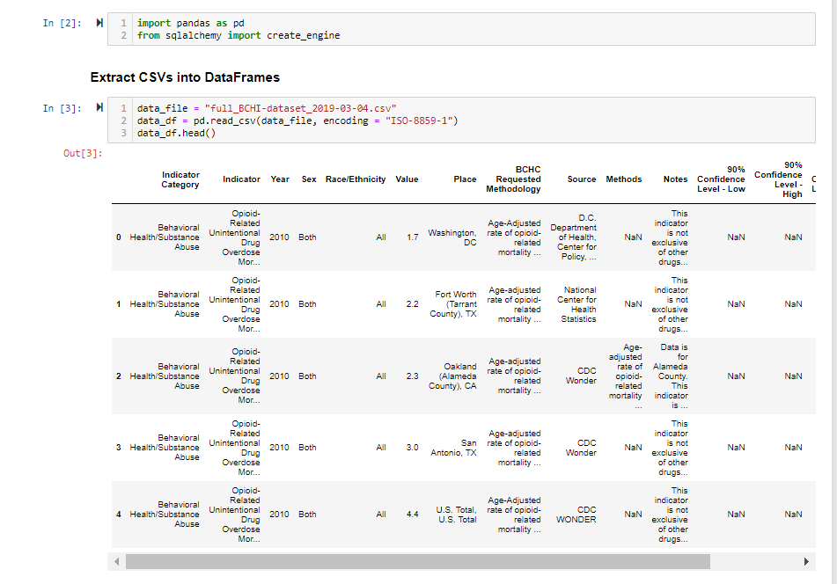
How did we get to the DATA??

Slide 5
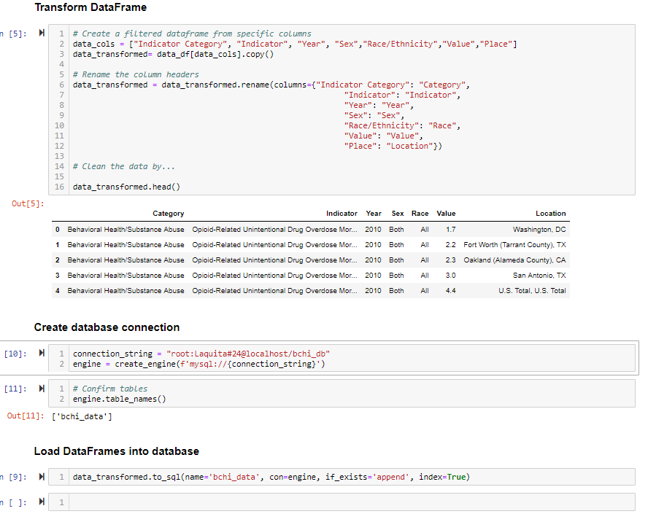

Slide 6
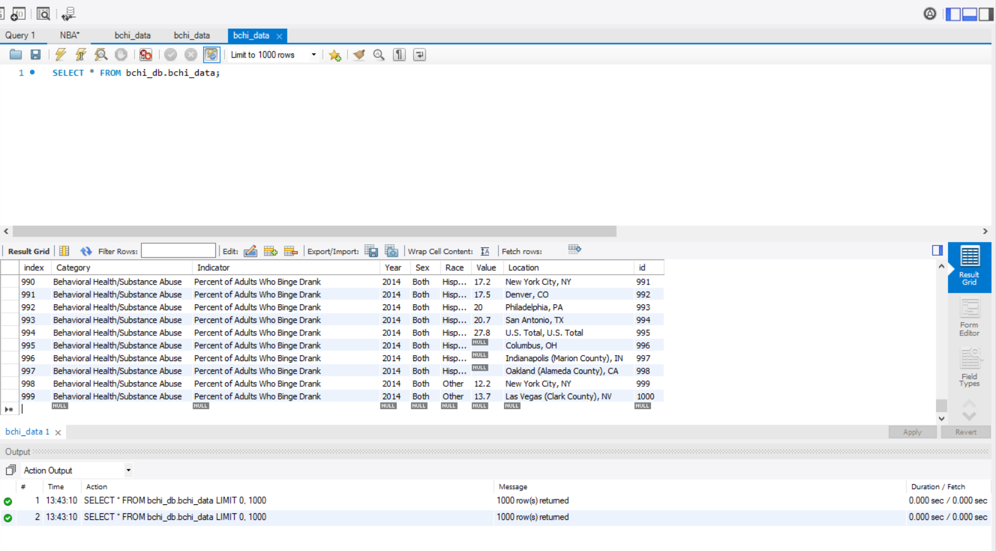

Slide 8
Screen shots

Slide 11
With more time we would like to have done.
-Make a Heat-Map

Slide 12
Problems along the way…..

